Slide 1
Chest Opacities detection using VGG19
Sharif Kiggundu
2022/HD05/1213U
Makerere University
Kampala, Uganda
sharifshars@gmail.com

Slide 2
Model Architecture
1. Pre-trained model on VGG-19 on the imagenet data set
2. Extraction of the VGG19 features and corresponding labels ( Feature Extraction)
3. Images sub-divided into sick and normal
4. Model built on top of the pre-trained VGG19 features using Keras API and used sigmoid as the activation function for the output layer
5. Compiling of the model
6. Optimization using Adam
7. Best model saved
(Total params: 23,593,473 Trainable params: 23,593,473 Non-trainable params: 0)
8. Training the model
8. Predication was done on the unknown images and evaluated on dataset 2

Slide 3
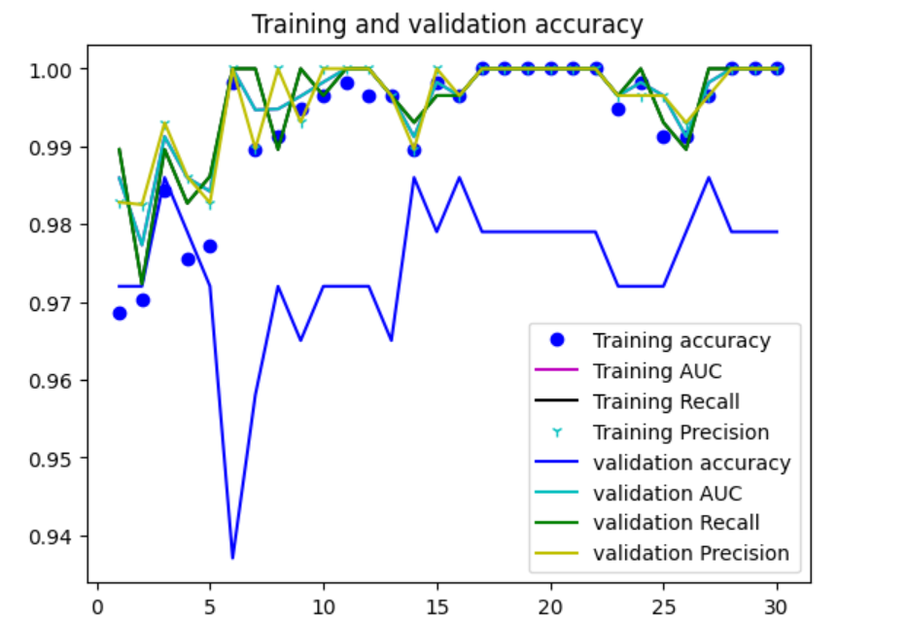
Metrics

Slide 4
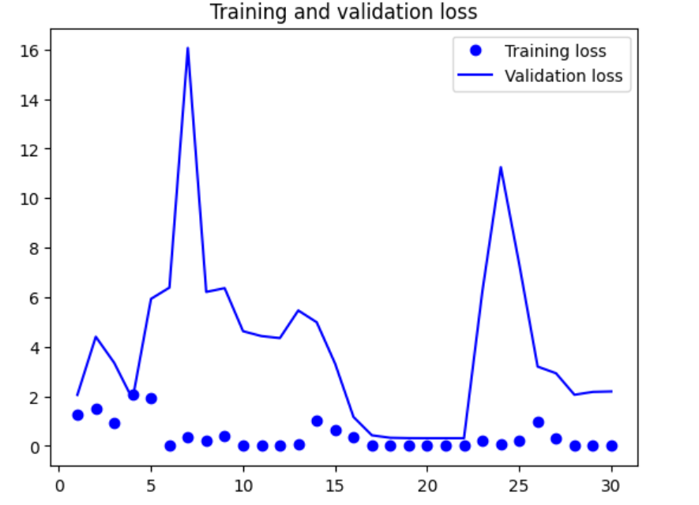
Metrics

Slide 5
Predictions on the unknown images in dataset 1

Slide 6
Evaluation of the model on dataset 2
Loss | Accuracy | AUC | Precision | Recall
850.9597 | 0.4464 | 0.4504 | 0.4739 | 0.8929

Slide 7
Experimental results (Sick and Normal)
See link for results

